Slide 1


Smart garbage monitoring system
Finalizing Hardware Requirements and ordering
Submitted By:
Lokesh Chinthakuntla-C0749681

Slide 2
Hardware Requirement
ARM mbedLPC1768 micro controller
GSM module
ESP8266 Wi-fi module
Ultrasonic sensor
LCD display
Power supply
Jumper wires and breadboard

Slide 3

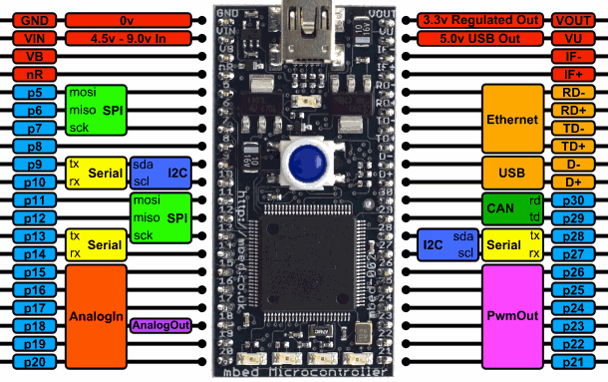
ARM mbedLPC1768 micro controller
The LPC1768 is a Cortex®-M3 microcontroller for embedded applications featuring a high level of integration and low power consumption at frequencies of 100 MHz
Up to 512 kB on-chip flash programming memory and 64 kB On-chip SRAM.

Slide 4
LPC1768
ARM Cortex-M3 core
• 100 MHz operation
• Nested Vectored Interrupt Controller for fast deterministic interrupts
• Wakeup Interrupt Controller allows automatic wake from any priority interrupt
Memory Protection Unit
• Four reduced-power modes: sleep, deep sleep, power-down and deep power-down
Memories
• 512 KB of Flash memory
• 64 KB of SRAM
Analog peripherals
• 12-bit ADC with eight channels
• 10-bit DAC

Slide 5
LPC1768
Serial peripherals
• 10/100 Ethernet MAC
• USB 2.0 full-speed device/Host/ OTG controller with on-chip PHY
• Four UARTs with fractional baud rate generation, RS-48, modem control, and IrDA
• Two CAN 2.0B controllers
• Three SSP/SPI controllers
• Three I 2 C-bus interfaces with one supporting Fast Mode Plus (1-Mbit/s data rates)
Other peripherals
Ultra-low-power (< 1 uA) RTC
• General-purpose DMA controller with eight channels
• Up to 70 GPIO
• Four 32-bit general-purpose timers/counters

Slide 6
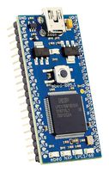
LPC1768
There is no software to install – everything, even the compiler, is online. The compiler and libraries are completely modular, so they’re easy to use. Web-based C/C++ programming environment
Integrated PMU (Power Management Unit)
Target Applications
Lighting
Industrial networking
Alarm systems
Motor control

Slide 7
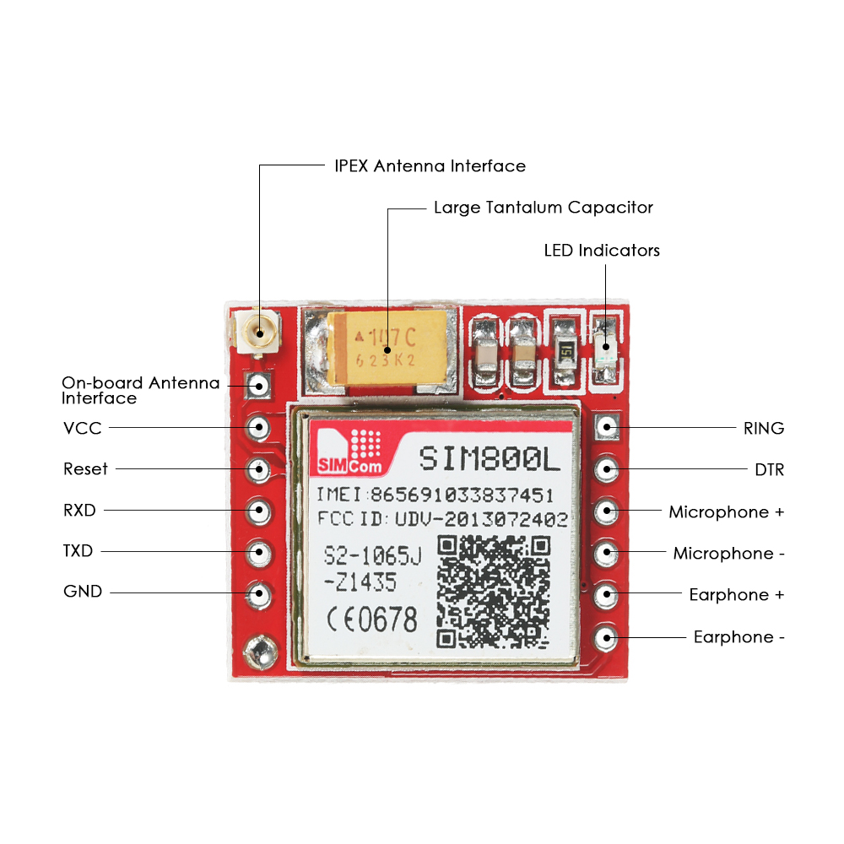
GSM module
Mini size and stable performance.
Supply voltage range 3.7V ~ 4.2V.
Low power consumption, 1mA in sleep mode.
With signal LED indicator onboard(with signal: flash slowly; no signal: flash fast).
Support 2G/3G/4G Micro SIM card.

Slide 8
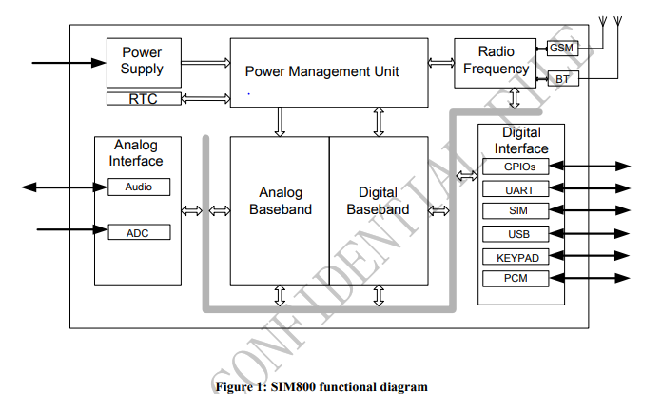
GSM module
Other features:
SMS cell broadcast
Text and PDU mode
Jamming Detection
Audio Record
Low power consumption

Slide 9
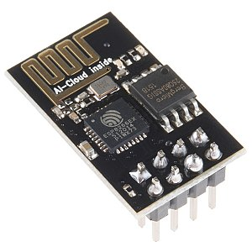
ESP8266 Wi-fi module
The ESP8266 is a low-cost wifi microchip, with a full TCP/IP stack and microcontroller capability, This small module allows microcontrollers to connect to a Wi-Fi network and make simple TCP/IP connections using Hayes-style commands
UART on dedicated pins, plus a transmit-only UART can be enabled on GPIO2
Flash memory:4MB
Digital I/O Pins:16
Analog input pins:1
Operating Voltage:3.3V

Slide 10
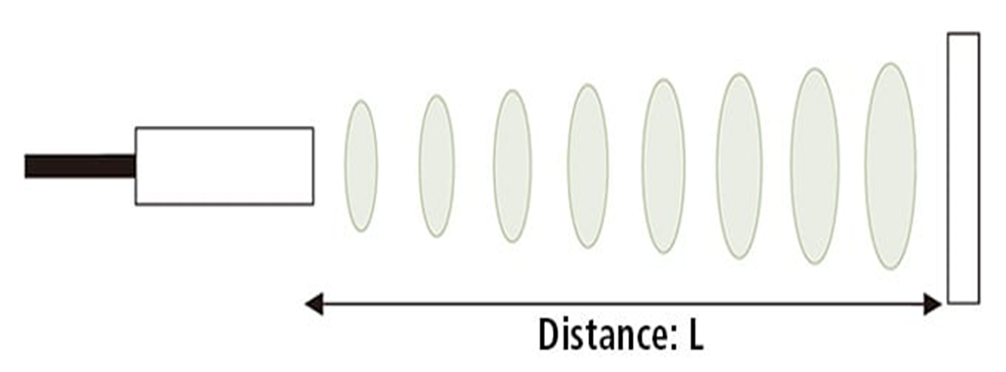
Ultrasonic sensor
Ultrasonic (US) sensor is a 4-pin module, are Vcc, Trigger, Echo and Ground respectively.
As the name indicates, ultrasonic sensors measure distance by using ultrasonic waves.
The sensor head emits an ultrasonic wave and receives the wave reflected from the target. ultrasonic sensors measure the distance to the target by measuring the time between the emission and reception.

Slide 11
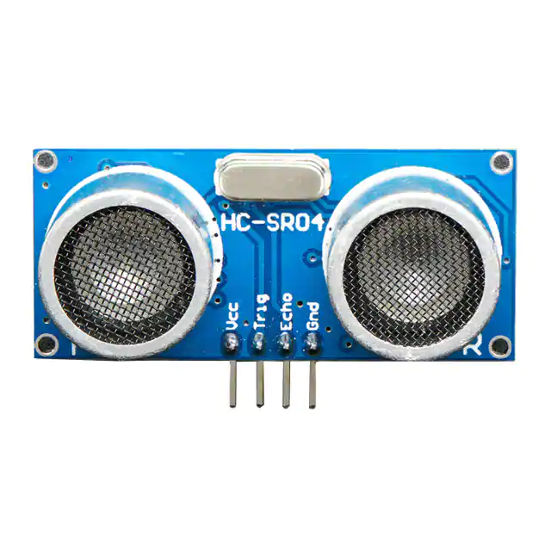
Ultrasonic Sensor:
Ranging from 2cm -400cm non-contact measurement function.
The ranging accuracy can reach to 3mm.
The module includes transmitter and Receiver.
Measuring angle of ultrasonic seniors 15 degree.
Dimension are 45*20*15mm.

Slide 12
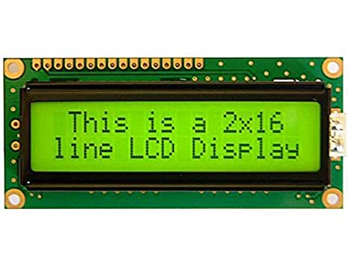
LCD display
Interfacing LCD with LPC1768.
In this project I2C protocol is used to communicate with LCD and it is serial communication.
16*2 LCD means it can display 16 charterers per line and there are 2 such lines. In this LCD character is displayed in 5*7 matrix format.
Operating Voltage is 3.0V to 5.3V.
Current consumption is 1mA without blacklight.
It can be configured either in 4-bit or 8-bit mode. The 4-bit mode helps in saving an extra 4-pins in the circuitry.
Available in green and blue Blacklight.

Slide 13
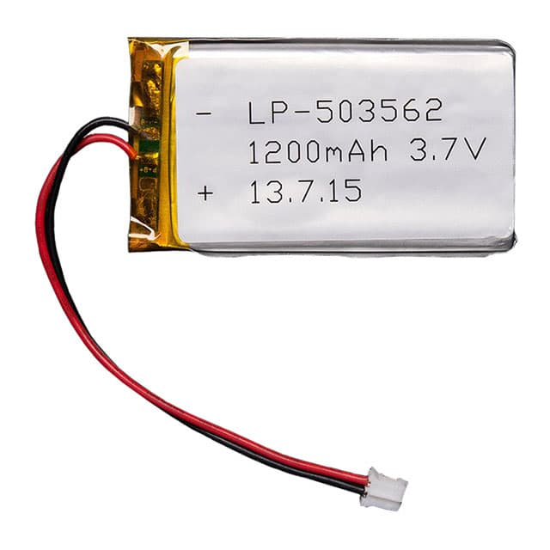
LI-ION Battery
Li-Polymer battery
Operating voltage:3.7V
Operating current: 1200mAh
We are using a Rechargeable Battery which is eco-friendly
Weight 23g
Dimensions 34mm x 62mm x 5mm

Slide 14
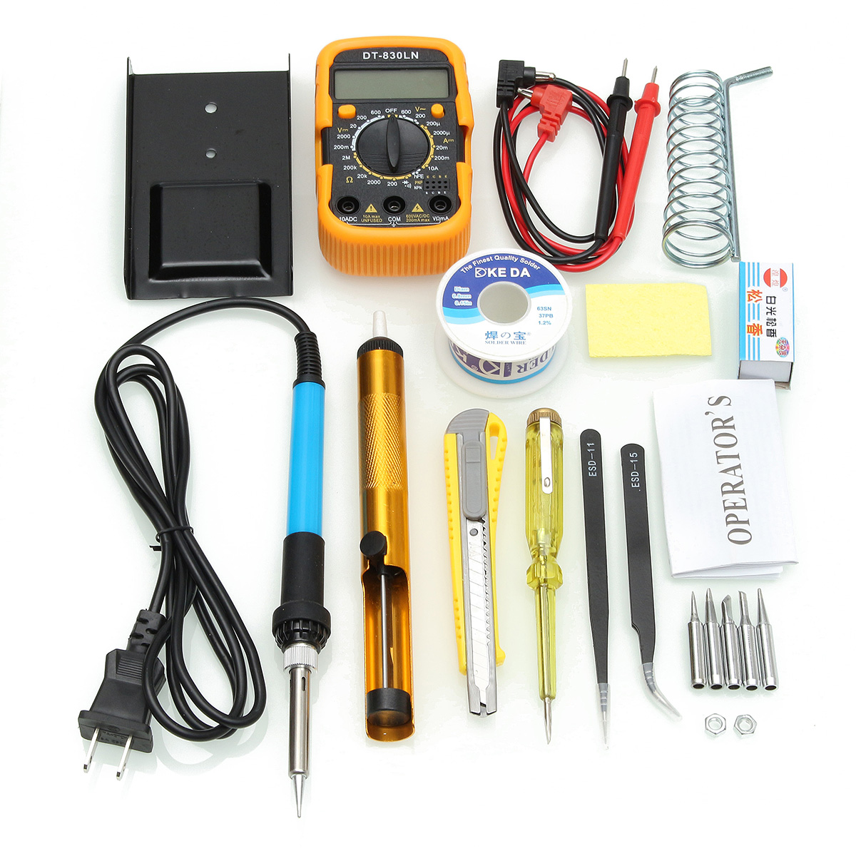
Solder Kit:
Solder kit contains:
Digital multimeter used to measure DC,AC voltages and DC,AC currents.
Desoldering pump is used to clean heated, molten solder out of solder joints and contact points.
1 soldering iron stand with cleaning sponge holds the soldering iron .
Tin wire tube and insulation tape

Slide 15
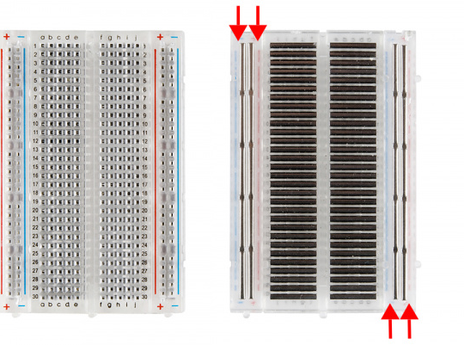
Breadboard
These are great units for making temporary circuits and prototyping, and they require absolutely no soldering.
Another common use of breadboards is testing out new parts, such as Integrated circuits (ICs).
Dimension: 6.5*4.4*0.3 inch
Hole/Pitch Style: Square wire holes (2.54mm)
Insulation Resistance : 500MΩ / DC500V
Withstanding Voltage : 1,000V AC / 1 minute

Slide 16
References:
Nxp.com. 2020. LPC1768FBD100|Arm Cortex-M3|32-Bit MCU | NXP. https://www.nxp.com/products/processors-and-microcontrollers/arm-microcontrollers/general-purpose-mcus/lpc1700-cortex-m3/512kb-flash-64kb-sram-ethernet-usb-lqfp100-package:LPC1768FBD100
Serial Port. (n.d.). Retrieved from https://store.qkits.com/wireless/sim800l-gprs-gsm-module-micro-sim-card-core-board-quad-band-ttl-serial-port.html
Anonymous, & Kruger, D. (n.d.). Retrieved from https://components101.com/ultrasonic-sensor-working-pinout-datasheet

Slide 17
References:
Lithium Ion Polymer Battery . (n.d.). Retrieved from https://www.buyapi.ca/product/lithium-ion-polymer-battery-3-7v-1200mah/
16x2 LCD Module. (n.d.). Retrieved from https://components101.com/16x2-lcd-pinout-datasheet
Breadboard. (n.d.). Retrieved from https://components101.com/misc/breadboard-connections-uses-guide

Slide 18
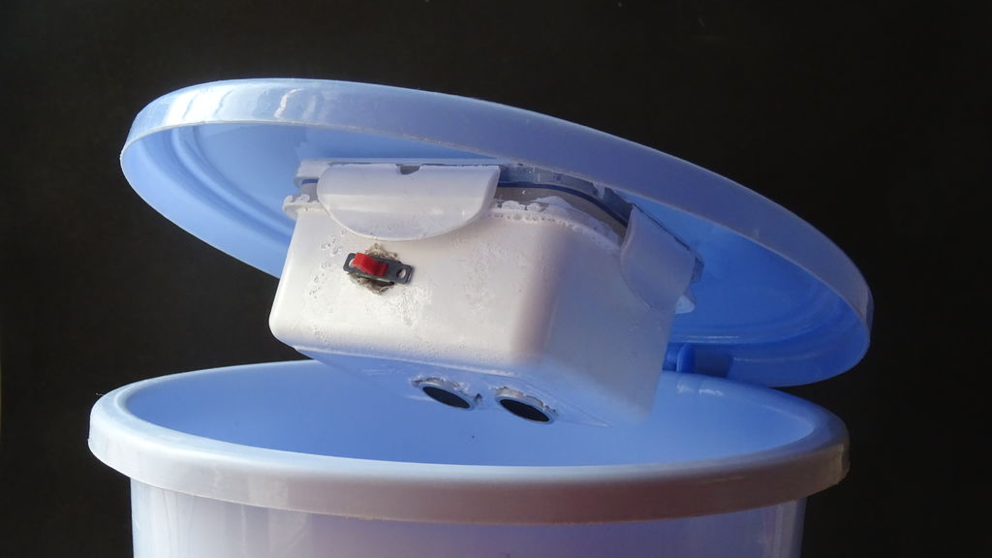
Thank you

